Slide 1
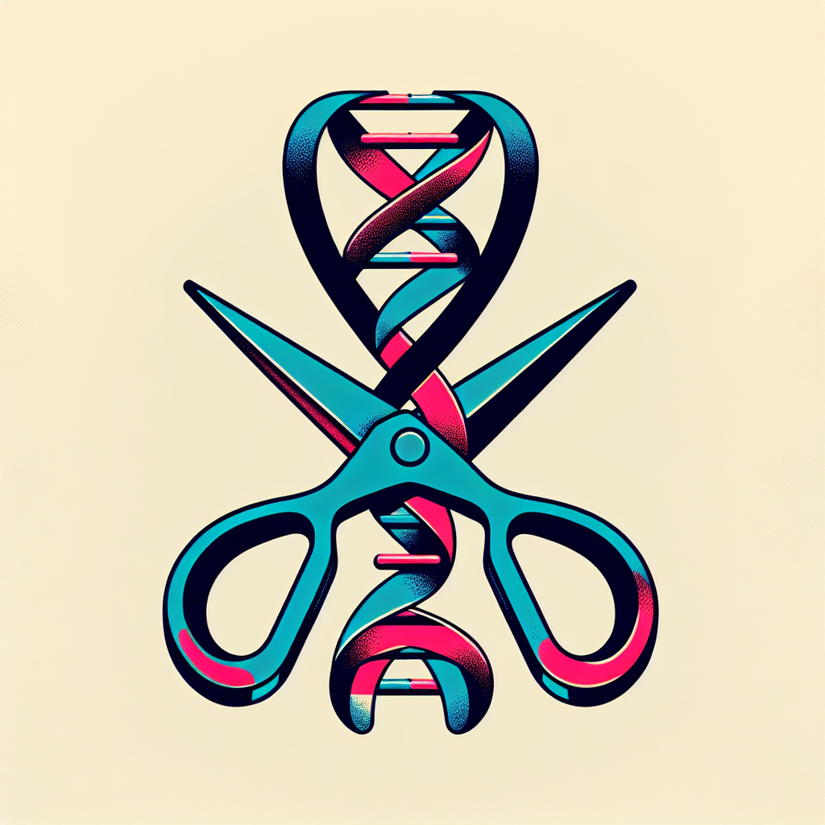
Programmable Medicine
Guided by a short RNA, CRISPR tools cut, nick, or rewrite DNA/RNA—turning sequence into a therapeutic address.

